Slide 1
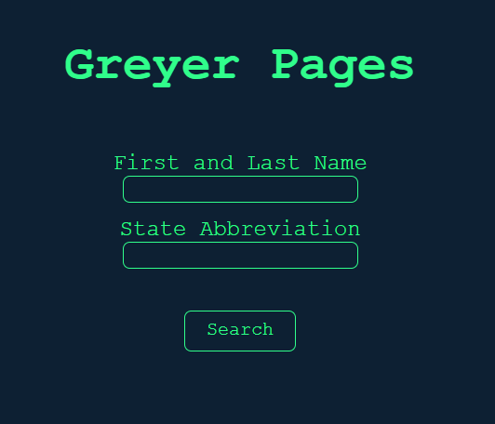
Greyer Pages
By: Adam Spera, Tyler Mui, Dustin Alburger

Slide 2
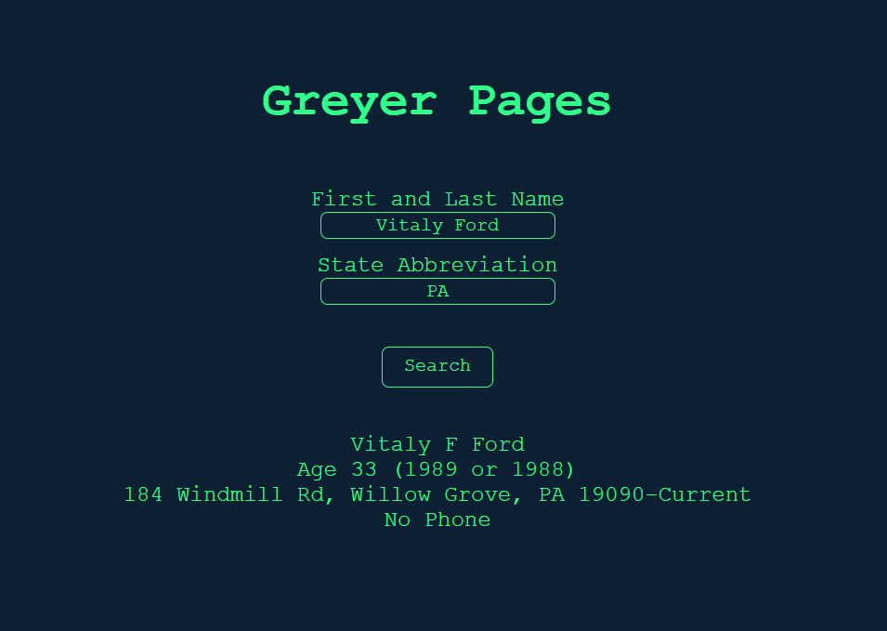
What is Greyer Pages
Greyer pages is a fun spin off of the website white pages.
Greyer pages takes in a target person's first name, last name, and state abbreviation to find the persons phone number and home address.
Greyer pages is both a python Terminal app as well as a Web App @ GreyerPages.com

Slide 3
Goals of Greyer Pages
The goal of greyer pages is to have a fun, interactive website that people can use to see if they can find themselves… or others
We chose to make this because it is another way to access this information, as a lot of people don't actually know that these resources are publicly available.

Slide 4
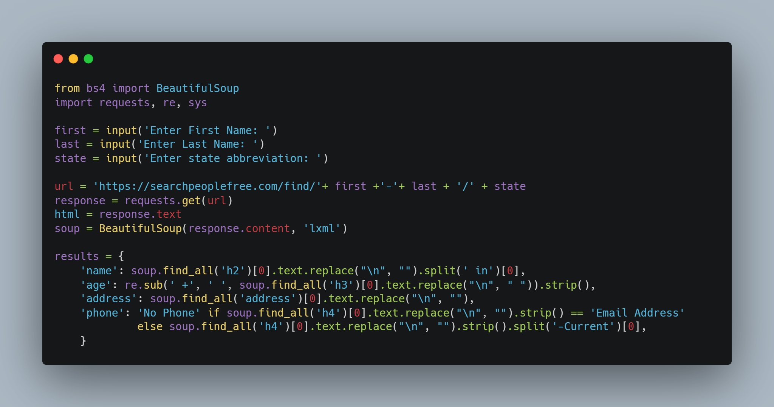
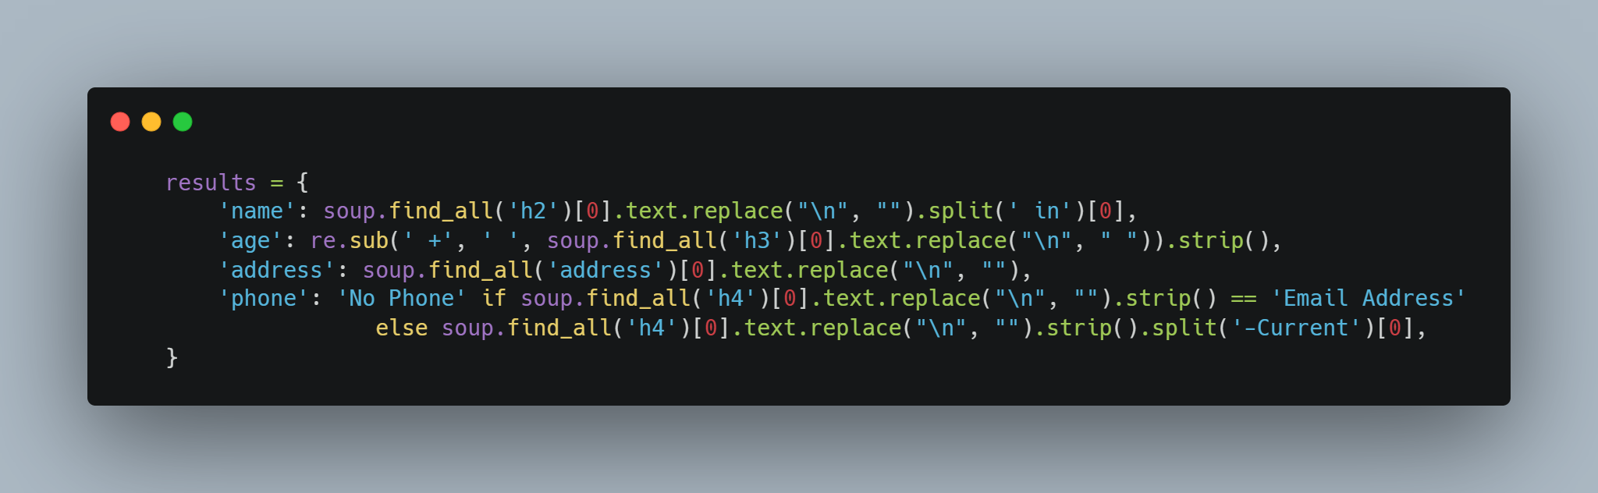
What it does and How it does it
Uses BeautifulSoup, a popular python package, to web scrape Searchpeoplefree.com
It then puts the information that is found into a hashmap and prints the values to the screen
BUG: It will not find the correct person sometimes since it only scrapes the first person to appear on the page
Using a hashmap is the most optimal data structure because it can store multiple pieces of data about one user inside one variable, while making it easy to read the code (keys being in plaintext when calling them)

Slide 5
Future Implementations
A future implementation we would like to add to both the web app and the terminal would be an undo/previous person button
Be able to accurately find the right person more often

Slide 6
Contributions
Dustin:
Planning, organization, and UX design
Tyler:
Terminal program
Adam:
Web app program

